Slide 1
CSS

Slide 2

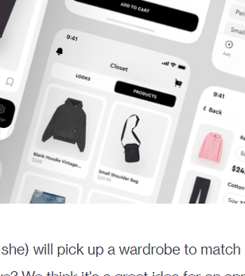
login.vue (after sign-up)
signup.vue
Initialise.vue (after sign-up)
Login
Text…….
Select your preferences
Text…….
Text…….
Text…….
Feed.vue <- post view
MyPage.vue
My posts:
scrollable
re
Posts I like:
re
Icons: Filter, feed, mypage

Slide 3
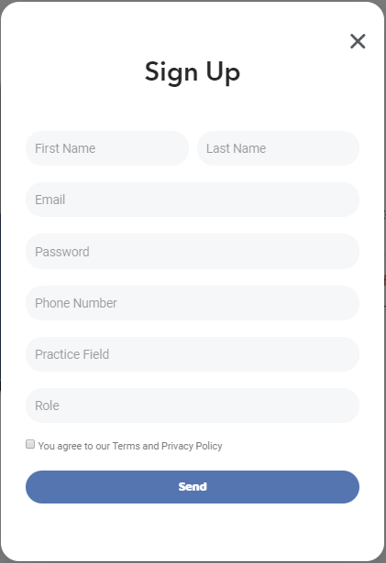
PostEditor.vue (after sign-up)
PhotoEditor.vue
Clickable only if a photo is added on the page
1
+
Crop, color filter, etc
Tags selector
save
PLACEHOLDER
Photo scaling,
Image filter,
Image fit
Effect
brightness

Slide 4
notes
User data:
This web needs login (user page), and persistent data.
Decided to save data to server instead of client side.
Information on posts (perhaps links) should be saved to the database too
Images:
https://stackoverflow.com/questions/4535627/where-is-the-best-place-to-save-images-from-users-upload
User uploads URL, and it will be saved to database
Backend:
Requires node.js -> allows us to run js script without browser
Requires node packages, ex. express.js
Package.json -> stores the package dependencies for each project
Run npm init command to deal with package.json file (entry point: the file where I’m inserting js script I want to run)

Slide 5
Backend
Users
User has ID, pwd
Posts
Contains user ID, URLS, phto settings
GET | api/feed | get all posts | GET
GET | api/postviewer/:id | get post by id | GET
POST | api/feed | add new post | POST
PUT | api/postmanager/:id | update post by id | PUT
DELETE | api/postmanager/:id | remove Tutorial by id | DELETE
DELETE | api/feed | remove all Tutorials | DELETE
GET | api/tutorials?title=[tag] | find all posts where title contains ’tag' | GET

